Slide 1
Foundation of Web Development (420-WA5-AB) Presentation Applications
Fall 2019

Slide 2
What is a presentation application?
A presentation application is a software package used to display information in the form of a slide show.
Slide show: a presentation of a series of still images on a projection screen or electronic display device
Typically in a prearranged sequence.
Has three major functions:
An editor that allows text to be inserted and formatted
A method for inserting and manipulating graphic images
A slide-show system to display the content.

Slide 3
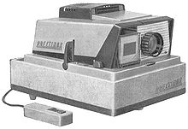
History
In the mid-1980s developments in the world of computers changed the way presentations were created.
Inexpensive, specialized applications now made it possible for anyone with a PC to create professional-looking presentation graphics.
These programs were used to generate 35 mm slides, to be presented using a slide projector.

Slide 4
History (2)
BRUNO: the first commercial computer software specifically intended for creating presentations was developed at Hewlett Packard in 1979.
Slidemaster: the first microcomputer-based presentation software developed by John F. Dunn and released by Cromemco in 1981.
VCN ExecuVision: the first software displaying a presentation on a personal computer screen in1982.
This program allowed users to choose from a library of images to accompany the text of their presentation.

Slide 5
Microsoft PowerPoint
PowerPoint is a presentation program.
Created by Robert Gaskins and Dennis Austin at Forethought software company in 1987.
Was initially intended for Macintosh computers only.
Microsoft acquired PowerPoint for $14 million three months after it appeared. First significant acquisition.
Today, Microsoft PowerPoint is one of leading programs that offers users many ways to display information from simple presentations to complex multimedia presentations.

Slide 6
Introduction to Microsoft PowerPoint

Slide 7
Viewing a Presentation
When you create a Blank Presentation in PowerPoint, the workspace opens in Normal view.
Normal view is divided into three areas:
Slide Pane: shows the full layout of a slide
Thumbnails: shows slide thumbnails
Notes Pane: used to input text relevant to a specific slide
Other views include Slide Sorter view which shows thumbnails of the entire presentation and Slide Show view where you preview your presentation as your audience will see it.

Slide 8
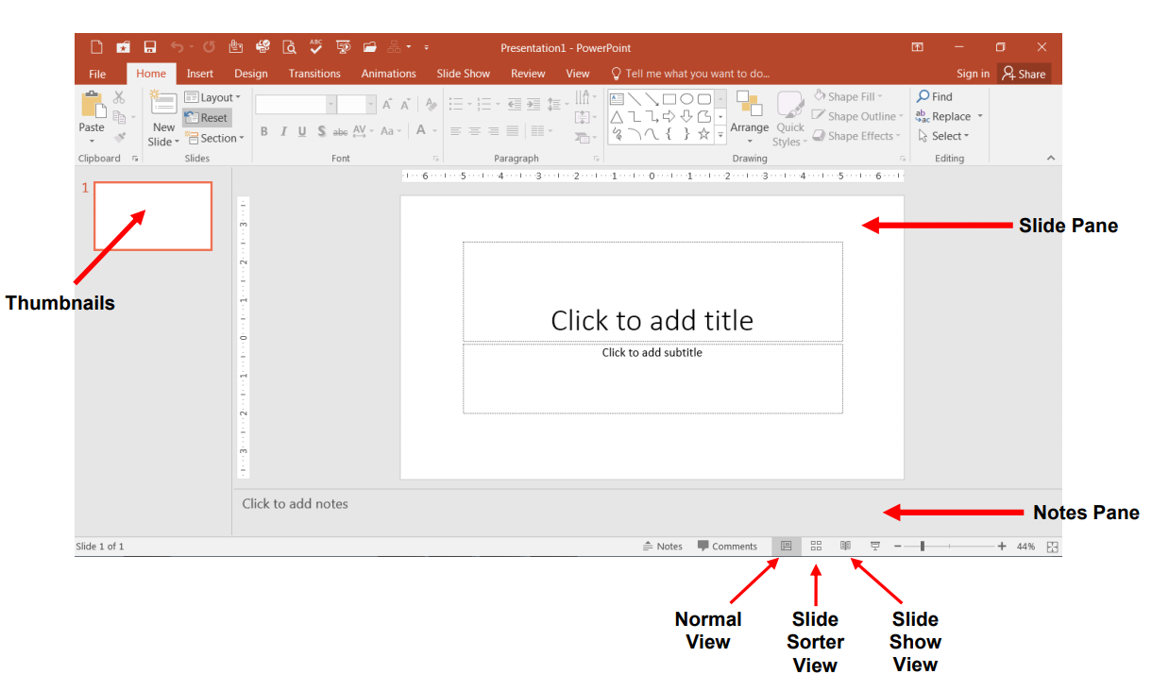
Viewing a Presentation

Slide 9
Creating a New Presentation
To Create a New Presentation:
Click on the File tab
Click on New
Select either a Blank Presentation, a featured theme or search for online templates and themes
Double-click Blank Presentation to create a new presentation

Slide 10
Entering Text on a Slide
When you create a new presentation, the first slide to appear is a Title slide.
It contains two placeholders:
A title placeholder
A subtitle placeholder.
To add text, click within the placeholder and type.

Slide 11
Formatting
PowerPoint provides a wide variety of themes that apply a distinctive look to the text, bullets, background colors, and graphics in a presentation.
Using a theme is a big time-saver and immediately adds a professional touch to your presentation. You can apply a theme when you create a new presentation and you can change the theme as many times as you want.
To Apply a Theme:
1) Click on the Design tab
2) Select one of the themes in the Themes group
To see more themes, click on the dialog box launcher.

Slide 12
Adding New Slides
Click on the Home tab
Click on New Slide in the Slides group
Choose a slide layout

Slide 13
Adding New Slides
Each slide in PowerPoint has a slide layout.
Slide layouts contain formatting, positioning, and placeholders for all of the content that appears on a slide.
PowerPoint includes nine built-in slide layouts:

Slide 14
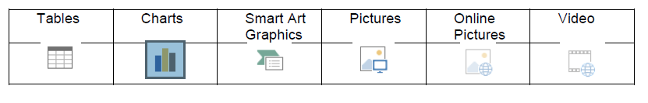
Content Slides
If you choose a slide with content, you will have six types of content to choose from.
Click on the type of content you want to create and PowerPoint will provide the tools needed to create it.

Slide 15
Applying Slide Transitions
A transition is a special effect that determines how a slide appears as it enters or leaves the screen.
To Apply Transitions:
Click on the Transitions tab .
Click on the drop down arrow in the Transition to This Slide group to see a listing of all available transitions.
Click on the transition you want to apply.
Click on Apply to All to apply the transition effect to the entire presentation .

Slide 16
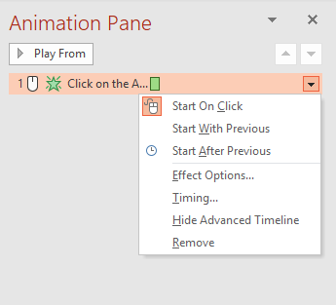
Applying Animations to Slide Elements
An animation is a special effect that determines how an element in a slide appears.
To Apply Animations:
Click on the Animations tab .
Choose a whole slide or elements in a slide.
Choose type of animation.
Options of animations can be changed using the Animation Pane.
Order to appear, with previous element, after or by click of the mouse.

Slide 17
Presentation Tips

Slide 18


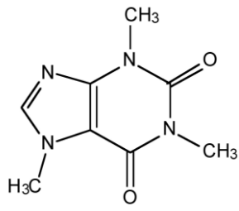

Know Your Audience
Caffeine causes the pituitary gland to release adrenaline which heightens awareness.
Caffeine can make people more aware of what is going on around them.

Slide 19
Organize Your Information
Organize your information clearly.
Be brief and clear.
Stick to no more than 2 - 3 statements per slide.
If using lists, make sure you leave enough space between lines of text.
Limit the number of slides (and aim to speak for 1 minute per slide).

Slide 20
Use Fonts And Sizes Sensibly
Choose sans-serif fonts as these are easier to read on screen.
Don’t use visually complex eccentric fonts that are hard to read, especially a combination of them.
USE CAPITAL LETTERS ONLY IN HEADLINES AND SECTION TITLES BUT NOT IN PARAGRAPHS OF TEXT.
Make sure your text is large enough to be read from a distance.

Slide 21
Keep Your Slides Concise
Don’t fill up the screen with lots and lots of information written in wordy sentences. Even if you use bullet points you shouldn’t have lots of them one after the other. The text that you show in your presentation should be guiding what you say, and not saying it all for you. If you have lots of text on a slide, then your audience will have to focus on reading it all and they will not be able to follow along with what you are saying. Plus, if you have lots of information then you will have to make the font size smaller and it will then be harder to read.

Slide 22
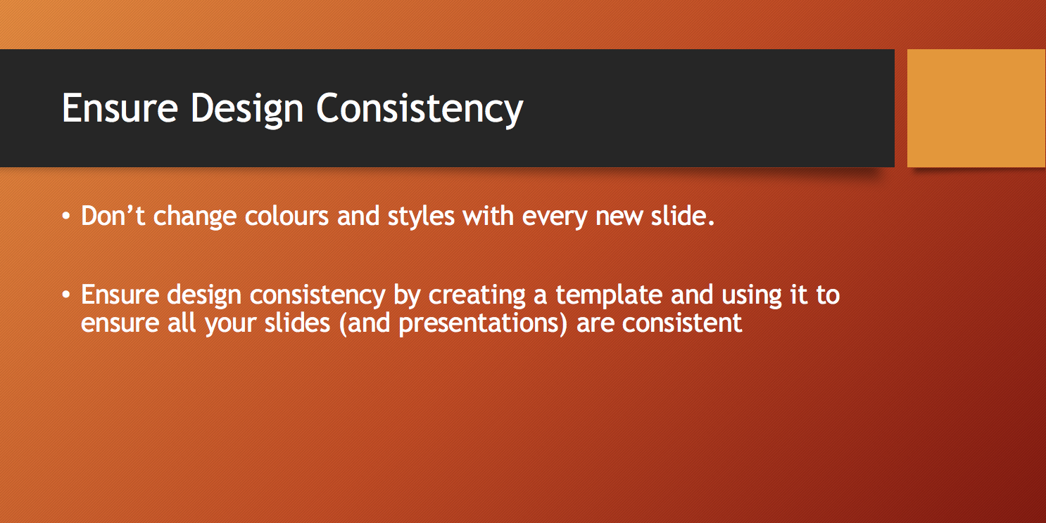

Slide 23
Highlight Key Words
Use keywords to help the audience focus on your message.
Be consistent in how you choose to highlight the important words in your textual content.
Avoid using underline as this can make your text harder to read. Also if you share your slides, many people will confuse underlined text with clickable hyperlinks. Using italics makes text harder to read.

Slide 24
Choose Colour Combinations Carefully
Use color combinations that are easy to read.
Stay away from colour combinations that are hard to read such as red and green.
Don’t use bright background colours that will strain your audience’s eyes.

Slide 25

Use Simple Backgrounds
Visually complex backgrounds can be distracting for the user, and make it hard for your audience to read your textual content.
Try to maintain a strong contrast between your text and background.

Slide 26

Use Visual Elements
Use visual elements to illustrate your ideas where appropriate.
Infographics and photo visuals can increase emotional appeal.
Graphs can help to show trends, relationships and comparisons.

Slide 27

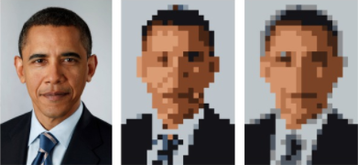
Use Images Sparingly
Don't add images for the sake of decoration. They must have a purpose.
Too many images can be distracting for your audience.
Low quality (pixelated) images look unprofessional.

Slide 28
Use Of Acronyms
Don’t use acronyms or technical terms unless you have previously prefaced them with the actual title/phrase and or relevant description.
IMHO an acronym rich environment is often hard for the audience to follow. IDK TBH you should explain any acronyms you use before you use them. KISS!
Ideally you should try to avoid the use of acronyms where possible.

Slide 29
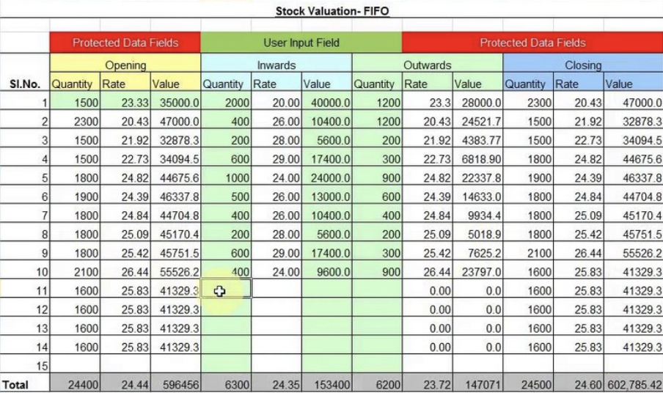
Avoid Using Data That Is Hard To Read

Slide 30
Don’t Overuse Special Effects
Animations and sounds can be used to enhance your ideas, but these should be used only when necessary.
According to research, 9 times out of 10 the animation is considered
annoying, unnecessary and irritating to the audience.
Think about whether your effects actually add value to the information you are presenting.

Slide 31
End With A Summary Slide
End with a summary slide which sums up the most important points of your presentation.
The most important sections of your presentation are the beginning and the ending.
The beginning is when you will grab the attention of the audience. The summary at the end will make it easier for them to remember your ideas.

Slide 32
Exercise
You have already did a research on
How does the use of “Social Media” affect our life in terms of privacy and productivity?
Download you research paper (assignment 1) from LEA.
Create a PowerPoint presentation about the research you did:
Choose a suitable layout.
Your audience will be Computer Science Students.
Your presentation should be between 5 and10 slides.
Summarize the ideas and remember not all the text will have to be moved to the presentation.
Follow the tips stated in this guide.
Well done presentations will be awarded a bonus point in Exam 3.

Slide 33
Resources
https://en.wikipedia.org/wiki/Presentation_program
http://www.garrreynolds.com/preso-tips/design/
http://www.ncsl.org/legislators-staff/legislative-staff/legislative-staff-coordinating-committee/tips-for-making-effective-powerpoint-presentations.aspx
Book: Microsoft PowerPoint 2016 – Step by Step
https://ptgmedia.pearsoncmg.com/images/9780735697799/samplepages/9780735697799.pdf

